Slide 1

Implementation of algorithms for Fusion of Pan-chromatic and Multi-Spectral Satellite Images
Presented by: Aniket Uppin (201EC169)
B.Tech 2nd year ,Electronics and Communication Engineering, National Institute of Technology Karnataka, Surathkal
Supervisor: Dr. Shyam Lal, Department of Electronics and Communication Engineering National Institute of Technology Karnataka, Surathkal Mangalore - 575025

Slide 2
Contents
1) Introduction
2) IHS Method and its results
3) GS-Method and its results
4) PCA Method and its results
5) Substitution Wavelet Method
6) Additional Wavelet method
7) Quantitative Metrics Analysis
8) Comparison of Images
9)References

Slide 3
Introduction
Remote sensing using high-resolution satellites has a wide range of social beneﬁt areas, such as infrastructure and transportation management, sustainable urban development, disaster resilience, sustainable precision agriculture, and energy and water resources management.
The demand for services and products that require users to discern features at high spatial and spectral precision has led most Earth observation service providers to develop geospatial products that use pansharpened satellite imagery that emerges from the fusion of the high spatial resolution panchromatic band and lower resolution multispectral bands.
Most modern satellite sensors carry onboard spectral bands of diﬀerent spatial resolutions and spectral frequencies.
In most instances, satellite sensors have narrow multispectral bands of relatively courser spatial resolution and a wide panchromatic band with higher spatial resolution.
To facilitate better image visualization, interpretation, feature extraction, and land cover classiﬁcation, an image fusion technique called pansharpening is used to merge the visible multispectral bands (red, blue, and green bands) and the panchromatic band to produce color images with higher spatial resolution.
Many studies have proved the value of pansharpened imaging in discerning geometric features from satellite imagery, cartography, geometric rectiﬁcation, change detection, and in improving land cover classiﬁcation accuracies.

Slide 4
Spatial and Spectral Resolution
The spatial resolution of a remote sensing imaging system is expressed as the area of the ground captured by one pixel and affects the reproduction of details within the scene.
As the pixel size is reduced, more scene details are preserved in the digital representation.
The instantaneous field of view is the ground area sensed at a given instant of time. The spatial resolution depends on the instantaneous field of view .
For a given number of pixels, the finer the instantaneous field of view is, the higher the spatial resolution.
Spatial resolution in remote sensing is usually expressed in meters or feet, which represents the length of the side of the area covered by a pixel.
Spectral resolution is the electromagnetic bandwidth of the signals captured by the sensor producing a given image.
The narrower the spectral bandwidth is, the higher the spectral resolution.
Spectral diversity is important for modeling the spectral characteristics of diﬀerent land cover/use classes and identifying them.

Slide 5
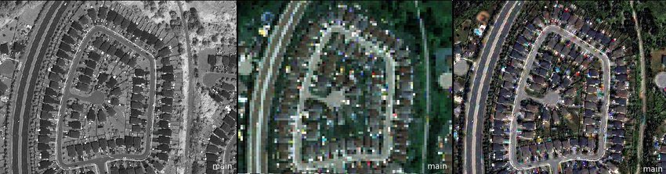
Pan-chromatic Image: Pan-chromatic images are gray-scale images which consists of wide range of wavelengths (spectral coverage) ranging from visible to near-infrared in a single band/channel. It has very high spatial resolution i.e., area of the ground captured by a pixel but has poor spectral resolution. Multi-spectral Image: Images which have several spectral bands. Since the bands have narrow spectral bandwidth, they have high spectral resolution but poor spatial resolution. Pan-Sharpening: It is a technique used to increase the spatial resolution of the multi-spectral images without affecting the spectral information.
What is Pan-sharpening?
Pan-chromatic
Multi-spectral
Pan-sharpened
Homeowners as Urban Forest Managers -Examining the Role of Property-level Variables in Predicting Variations in Urban Forest Quantity Using Advanced Remote Sensing and GIS Methodologies.
Department of Geography University of Toronto

Slide 6
Many pansharpening techniques have been developed over time to enable users to fully exploit the spatial and spectral characteristics available on most satellite systems.
Image Fusion (Pan-Sharpening) Methods :
IHS Method
Modified GS(Gram-schmidt) Method
PCA (princinpal Component Analysis)
Wavelett Method i) Substitution Method
ii) Additional method
IHS ,GS and PCA methods come under component substitution method where the key idea is to inject pan band into the transformed channel of the multi-spectral images
Wavelet methods fall under MRA (multi-resolution Analysis) which fuse the high frequencies in pan-band into multi-spectral channels through multi-resolution decomposition.

Slide 7
1)Bicubic Interpolation
Pseudo code
define function bicubic (pan, ms)
M,N,C ← dimensions of pan
m,n,c=dimensions of ms
compute ratio ← M/m
samp_img ← upsample ms image with ratio
set samp_img values <0 to 0
set samp_img values >1 to 1
return samp_img
load pan image
load ms image
out ← bicubic(pan, img)
display pan, ms, out
This is a basic method which does the upsampling of multi-spectral images in accordance to the dimensions of the panchromatic images

Slide 8
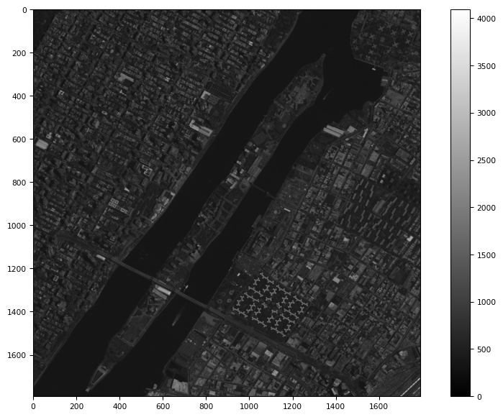
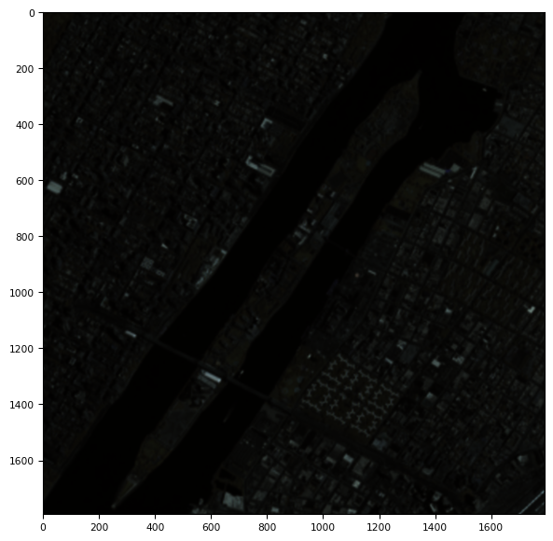
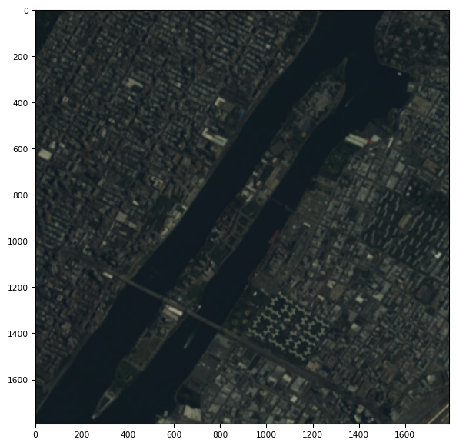
Pan-chromatic image
Multi-spectral Image
3-channel multi-spectral image
Input images used for all the following methods

Slide 9
1) IHS transformation image
Pseudo Code
import libraries and packages
define function ihs (pan,ms)
M,N,C ← dimensions of pan
m,n,c=dimensions of ms
compute ratio ← M/m
u_ms ← upsample ms image with ratio
I ← mean(u_ms) across channels
#matching histogram of pan image and I
gain ← standard deviation(I)/standard deviation(pan)
bias ← mean(I) – gain*mean(pan)
set P_mod ← pan*gain + bias
set out ← u_ms + (P_mod) repeated along channels
return out
load pan and ms image
out ← ihs(pan,ms)
display pan,ms,out
The IHS method involves:
Up-sampling the multi-spectral image
Performing the IHS transform over the three spectral bands
Matching the statistical features of the high resolution pan and the I-channel of the transformed image.
Replacing the I-channel with the modified pan band.
Doing an inverse transform

Slide 10
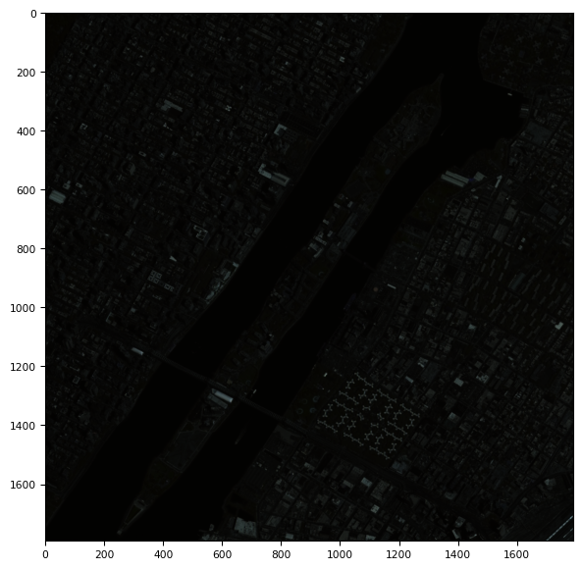
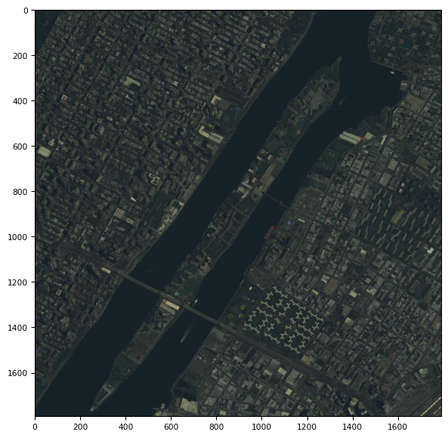
Multi-spectral Image
Pan-sharpened

Slide 11
2) GS Method
Pseudo Code
import libraries and packages
define function gs(pan,ms)
M,N,C ← dimensions of pan
m,n,c=dimensions of ms
compute ratio ← M/m
u_ms ← upsample ms image with ratio
#creating low resolution pan image
pan_lr ← blur(pan)
pan_lr ← downsample(pan_lr)
initialize matrix gs ← zeros(dimensions m,n,c)
gs[:,:,0] ← pan_lr
# applying gs transform (making each channel orthogonal to pan_lr image)
for i : 1 to c
intitalise s ← 0
for j :0 to i
s=covariance(ms[i],gs[j])/variance(gs[j],gs[j]) * gs[j]
gs[i] ← ms[i] - mean(ms[i]) + s
In this method a lower resolution pan band is simulated from the high resolution pan band.
Then with this being the first channel and all the other consequent multi-spectral channels undergo GS transformation.
Then the statistics of the pan band is matched with the first channel of the transformed band .
Finally this histogram-modified pan band is substituted for the first transformed band leading to new transform bands and inverse GS transformation is performed.
Actually the GS transformation does the orthogonalization of the data, thereby removing the redundant data.

Slide 12
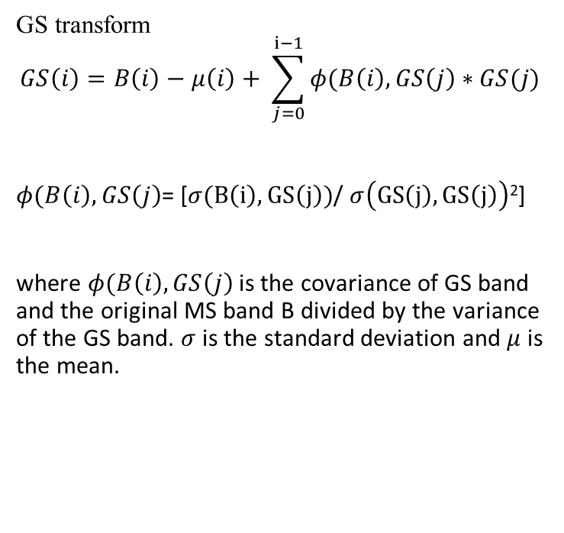
GS method
#matching histogram of pan image and gs[0]
gain ← standard deviation(gs[0])/standard deviation(pan)
bias ← mean(gs[0]) – gain*mean(pan)
set p_mod ← pan*gain + bias
gs[0] ← p_mod
#applying inverse transform
for i : 1 to c
intitalise s ←0
for j :0 to i
s= covariance(ms[i],gs[j])/variance(gs[j],gs[j]) * gs[j]
ms[i] ← gs[i] - mean(ms[i]) + s
return ms
load pan and ms image
out ← gs(pan,ms)
display pan,ms,out
GS transform
$$GS\left(i\right)=B\left(i\right)−μ\left(i\right)+ \sum_{j=0}^{ⅈ−1}{φ(B\left(i\right),GS\left(j\right)∗GS(j)}$$
$φ(B\left(i\right),GS\left(j\right)$= [$σ(B\left(i\right),GS\left(j\right))$/ $σ\left(GS\left(j\right),GS\left(j\right)\right)$²]
where $φ(B\left(i\right),GS\left(j\right)$ is the covariance of GS band and the original MS band B divided by the variance of the GS band. $σ$ is the standard deviation and $μ$ is the mean.

Slide 13
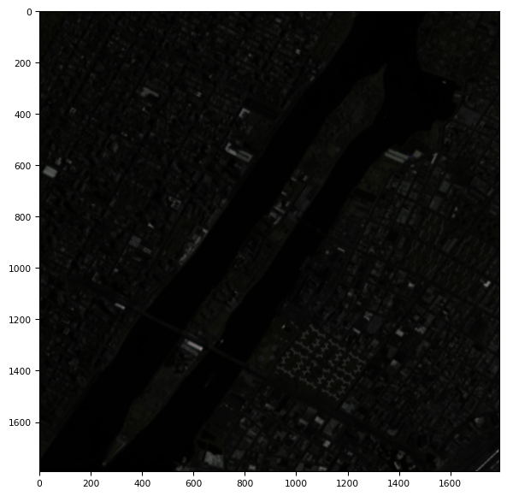
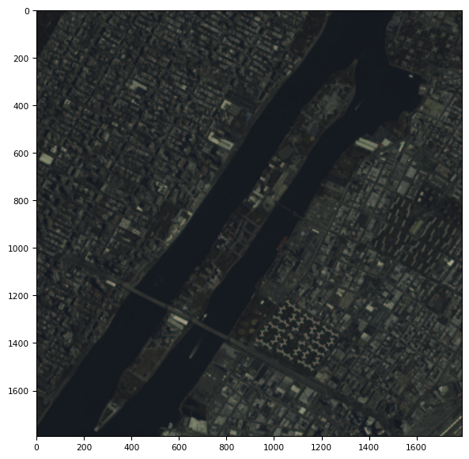
Multi-spectral Images
Pan-sharpened

Slide 14
3) PCA method
Pseudo code
import libraries and packages
define function pca(pan,ms)
M,N,C ← dimensions of pan
m,n,c=dimensions of ms
compute ratio ← M/m
u_ms ← upsample ms image with ratio
# applying pca transform
p=pca( c no.of components)
pca_img =p.fit_transform( u_ms)
pca_img[0] ← pan
#matching histogram of pan image and pca_img[0]
gain ← standard deviation(pca[0])/standard deviation(pan)
bias ← mean(gs[0]) – gain*mean(pan)
set p_mod ← pan*gain + bias
pca_img[0] ← p_mod
#applying inverse transform
set I_pca ← p.inverse_transform(pca_img)
I_pca ← I_pca + mean(u_ms)
return i_pca
load pan and ms image
out ← pca(pan,ms)
display pan,ms,out
It converts the inter-correlated multispectral components into new set of unrelated components. This is achieved by finding principal components of all multispectral channels.
Then the high resolution pan is matched with the histogram of the first PCA component ,and then the modified pan band is replaced by the first component and finally pan-sharpened image is obtained by doing an inverse transform.

Slide 15
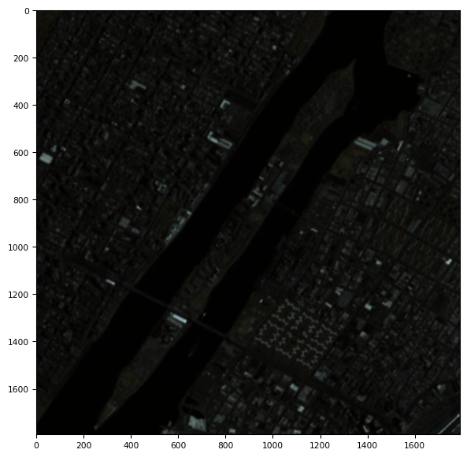
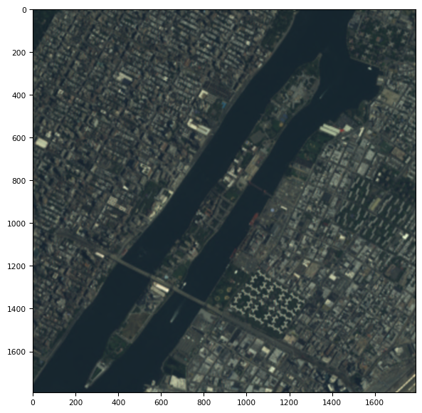
Multi-spectral Images
Pan-sharpened

Slide 16
4) Wavelet Method
Wavelet transform provides a way to decompose an image thereby separating the spatial information into different labels.
The wavelet method divides the mage into low and high frequency components
The key idea is to decompose the image into 2 levels(wavelet planes) using ‘haar’ extension mode. So the first channel (approximation) that is obtained by subsequent low pass band filtering replaces the first approximation of the pan-band and the an inverse wavelet/reconstruction takes place to give the pan-sharpened image.

Slide 17
4i) Substitution Wavelet
Pseudo Code
import libraries and packages
define function s_wav(pan,ms)
M,N,C ← dimensions of pan
m,n,c=dimensions of ms
compute ratio ← M/m
u_ms ← upsample ms image with ratio
intensity ← mean(r,g,b)
gain ← standard deviation(intensity)/standard deviation(pan)
bias ← mean(intensity) – gain*mean(pan)
set p_mod ← pan*gain + bias
set wav ← wavedec2(p_mod , ‘haar’ ,2 levels)
for i :0 to c
set temp ← wavedec2(u_ms,’haar’, 2 levels)
temp[0] ← wav[0]
rev_wav ← waverec2(temp,’haar’)
out .append(rev_wav)
return out
load pan and ms image
out ← s_wav(pan,ms)
display pan,ms,out
In substitution method, the images are sharpened by substituting first wavelet planes of each of the channel of the multi-spectral images by the first wavelet plane of the pan-chromatic image and then transformed back to obtain the resultant image.

Slide 18
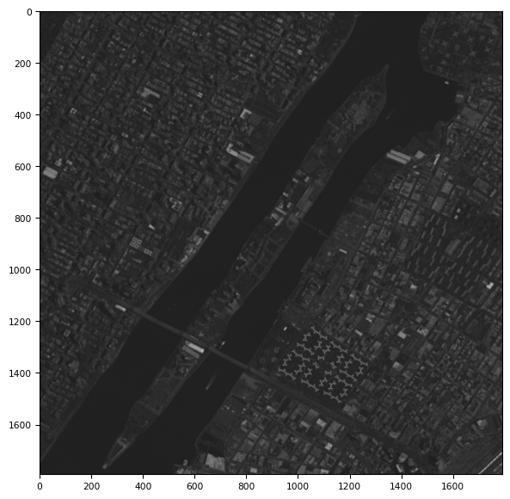
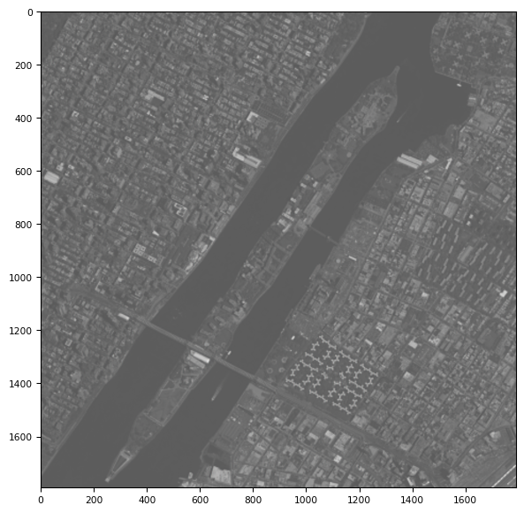
Multi-spectral Images
Pan-sharpened

Slide 19
4ii) Addition Wavelet
Pseudo code
import libraries and packages
define function a_wav(pan,ms)
M,N,C ← dimensions of pan
m,n,c=dimensions of ms
compute ratio ← M/m
u_ms ← upsample ms image with ratio
h,s,v ← rgb2hsv(u_ms)
set wav ← wavedec2(p_mod , ‘haar’ ,2 levels)
v ← v + wav[0]
rgb ← hsv2rgb(h,s,v)
return rgb
load pan and ms image
out ← a_wav(pan,ms)
display pan,ms,out
In addition method, the image is converted to IHS color space and the wavlet decomposed pan-chromatic plane is added to the intensity channel of the image and is transformed back to RGB space to obtain the resultant image.

Slide 20
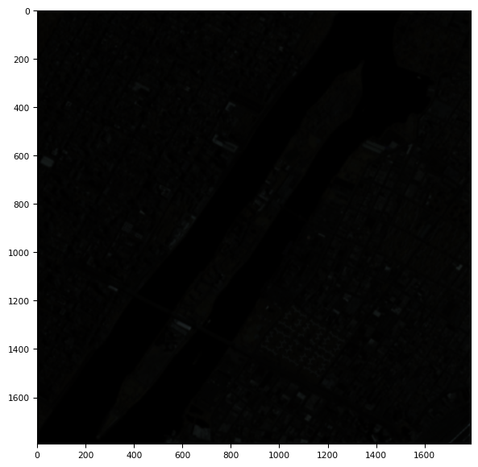
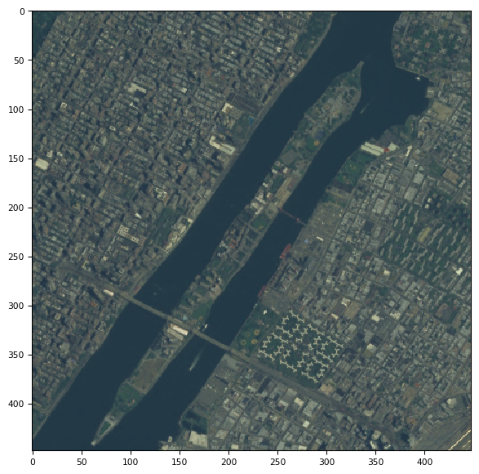
Multi-spectral Images
Pan-sharpened

Slide 21
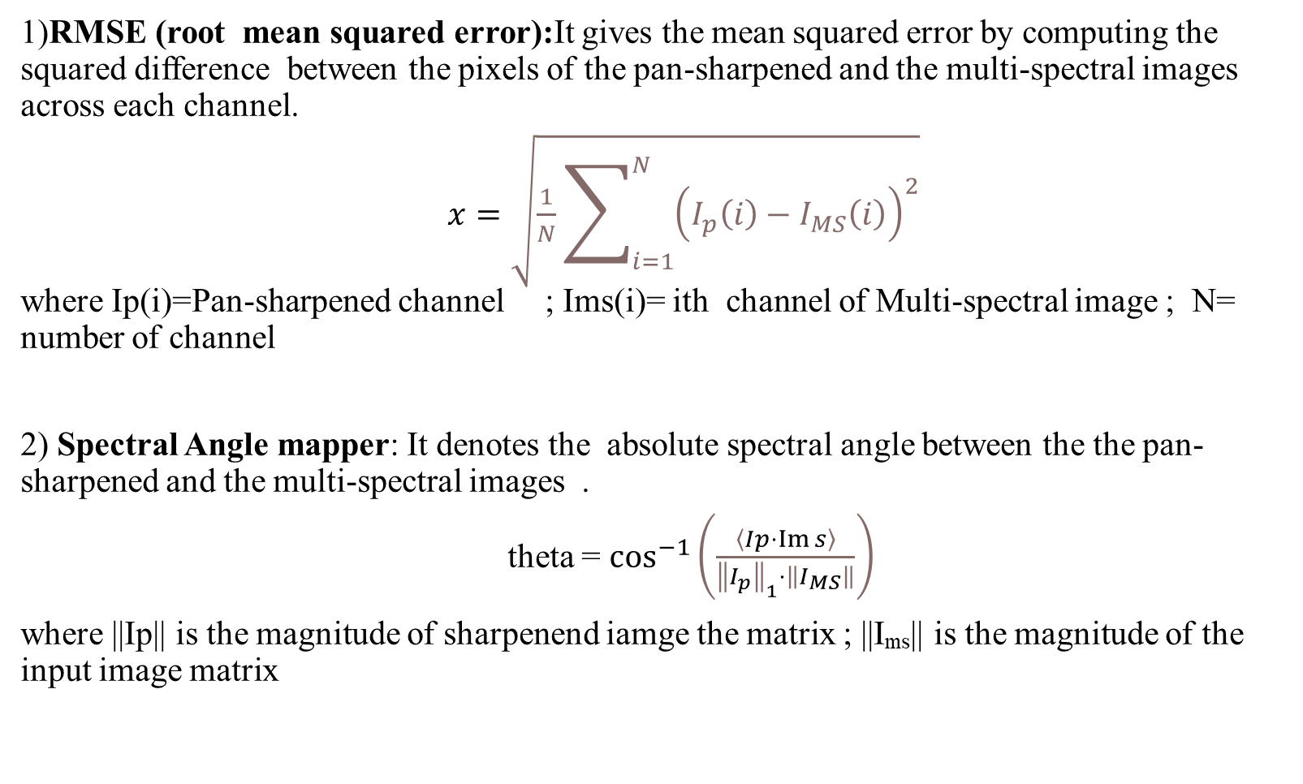
Quantitative Analysis: Image Quality Metrics
1)RMSE (root mean squared error):It gives the mean squared error by computing the squared difference between the pixels of the pan-sharpened and the multi-spectral images across each channel.
$x=\sqrt{\frac{1}{N}\sum_{i=1}^{N}{{\left(I_{p}\left(i\right)−I_{MS}\left(i\right)\right)}^{2}}}$ where Ip(i)=Pan-sharpened channel ; Ims(i)= ith channel of Multi-spectral image ; N= number of channel
2) Spectral Angle mapper: It denotes the absolute spectral angle between the the pan-sharpened and the multi-spectral images .
theta = $\cos^{−1}\left(\frac{\left\langle Ip⋅\operatorname{Im}{s}\right\rangle }{{\left\|I_{p}\right\|}_{1}⋅\left\|I_{MS}\right\|}\right)$
where ||Ip|| is the magnitude of sharpenend iamge the matrix ; ||I_{ms}|| is the magnitude of the input image matrix

Slide 22
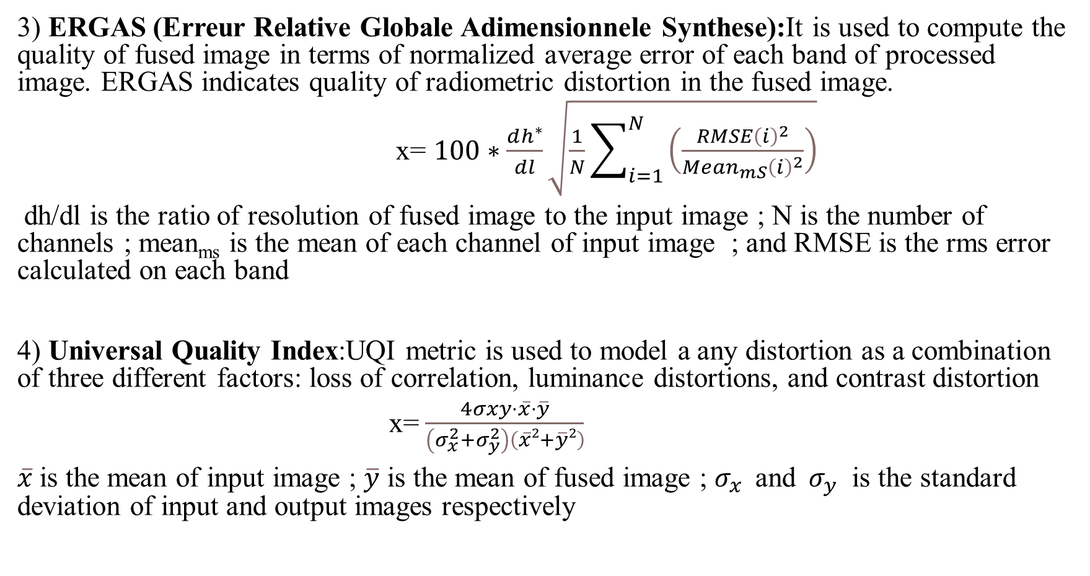
3) ERGAS (Erreur Relative Globale Adimensionnele Synthese):It is used to compute the quality of fused image in terms of normalized average error of each band of processed image. ERGAS indicates quality of radiometric distortion in the fused image.
x= $100∗\frac{ⅆh^{∗}}{dl}\sqrt{\frac{1}{N}\sum_{i=1}^{N}{\left(\frac{RMSE{\left(i\right)}^{2}}{Mⅇan_{mS}{\left(i\right)}^{2}}\right)}}$
dh/dl is the ratio of resolution of fused image to the input image ; N is the number of channels ; mean_{ms} is the mean of each channel of input image ; and RMSE is the rms error calculated on each band
4) Universal Quality Index:UQI metric is used to model a any distortion as a combination of three different factors: loss of correlation, luminance distortions, and contrast distortion
x= $\frac{4σxy⋅\overline{x}⋅\overline{y}}{\left(σ_{x}^{2}+σ_{y}^{2}\right)\left(\overline{x}2+\overline{y}2\right)}$
$\overline{x}$is the mean of input image ; $\overline{y}$ is the mean of fused image ; $σ_{x }$ and${ σ}_{y}$ is the standard deviation of input and output images respectively

Slide 23
Metrics comparison
Methods | IHS | Gram-Schmidt | PCA | Substitution Wavelet | Addition Wavelet
Root Mean Square Error (RMSE) | 142.9389 | 65.795 | 1.8445e-11 | 1042.471 | 5588.0227
Spectral Angle Mapper(SAM) | 0.981 | 5.873e-09 | 1 | 0.949 | 0.8347
Universal Quality Index (UQI) | 0.8871 | 0.9703 | 0.999 | 0.949 | 0.009680
ERGAS | 1.7699 | 0.8264 | 5.868319194056666e-07 | 4.812 | 10.7046

Slide 24
Pan |  | IHS | Gram - Schmidt | PCA | Substitution wavelett | Addition Wavelett
MS -4 band
MS – 3 band

Slide 25
References:
[1]. Alireza Rahimzadeganasl , Ugur Alganci and Cigdem Goksel. An Approach for the Pan Sharpening of Very
High Resolution Satellite Images Using a CIELab Color Based Component Substitution Algorithm. Appl. Sci.
2019, 9, 5234; doi:10.3390/app9235234
[2]. Israa Amro ,Javier Mateos, Miguel Vega, Rafael Molina and Aggelos Katsaggelos. A survey of classical
methods and new trends in pansharpening of multispectral images Journal on Advances in Signal
Processing 2011, http://asp.eurasipjournals.com/content/2011/1/79.
[3]. Paidamwoyo Mhangara ,Willard Mapurisa and Naledzani Mudau. Comparison of Image Fusion Techniques
Using Satellite Pour l’Observation de la Terre (SPOT) 6 Satellite Imagery. Appl. Sci. 2020, 10, 1881;
doi:10.3390/app10051881.
[4]. Naidu Jamuna Bhaskarrajan. Satellite Image Fusion using IHS and PCA Method. International Journal of
Innovative Science, Engineering & Technology, Vol. 1 Issue 7, September 2014.
[5]. Meng Xiangchaoa, Shen Huanfengb,Li Huifangb, Zhang Liangpeic, Fu Randi. Review of the
pansharpening methods for remote sensing images based on the idea of meta-analysis: Practical
discussion and challenges. https://doi.org/10.1016/j.inffus.2018.05.006
[6]. T. Maurer. How To Pan-sharpen Images Using The Gram-schmidt Pan-sharpen Method. International Archives
of the Photogrammetry, Remote Sensing and Spatial Information Sciences, Volume XL-1/W1, ISPRS
Hannover Workshop 2013, 21 – 24 May 2013, Hannover, Germany
[7]. Jorge Nu´nez, Xavier Otazu, Octavi Fors, Albert Prades, Vicen¸ c Pala, and Rom `an Arbiol. Multiresolution-
Based Image Fusion with Additive Wavelet Decomposition. Ieee Transactions On Geoscience And Remote
Sensing, Vol. 37, No. 3, May 1999.
[8]. Craig A. Laben, Penfield; Bernard V. Brower, Webster. Process For Enhancing The Spatial Resolution Of Multispectral Imagery Using Pan-sharpening. Appl. No.: 09/069,232 . Jan. 4, 2000

Slide 26
References: [9]. Alparone, L., Aiazzi, B., Baronti, S., Garzelli, A., Nencini, F., Selva, M., 2008. Multispectral and Panchromatic Data Fusion Assessment Without Reference. Photogramm. Eng. Remote Sens. 74, 193–200. [10]. Jagalingam Pa, Arkal Vittal Hegde. A Review of Quality Metrics for Fused Image. (http://creativecommons.org/licenses/by-nc-nd/4.0/). [11]. Wald L., 2000. Quality of high resolution synthesised images: Is there a simple criterion ?. In Proceedings of the third conference "Fusion of Earth data: merging point measurements, raster maps and remotely sensed images", Sophia Antipolis, France, January 26-28, 2000, Thierry Ranchin and Lucien Wald Editors, published by SEE/URISCA, Nice, France, pp 99-103. [12]. Zhou Wang, Alan C.Bovik .A Universal Image Quality Index.IEEE Signal Processing Letters.March 2002 [13]. Farzaneh Dadrass Javan, Farhad Samadzadegan , Soroosh Mehravar , Ahmad Toosi , Reza Khatami, Alfred Stein . A review of image fusion techniques for pan-sharpening of high-resolution satellite imagery. https://doi.org/10.1016/j.isprsjprs.2020.11.001

